Slide 1

Travel Vista: Tourism Recommendation System
Presented By
P. Sudhakar Reddy
G. Shoyab Ali Khan
P. Nethravathi
R. Sandeep Gowda

Slide 2
Agenda
Abstract
Introduction
Objectives
Hardware & Software Requirements
Dataset
Architecture Diagram
Conclusion
Future Enhancements

Slide 3

Abstract
The Tourism Recommendation System leverages natural language processing techniques to analyze descriptions of cities and places, enabling it to suggest relevant destinations based on user-selected criteria.
By offering tailored recommendations, this system aims to enhance the travel planning experience, making it easier for users to discover new and exciting destinations that align with their interests.

Slide 4
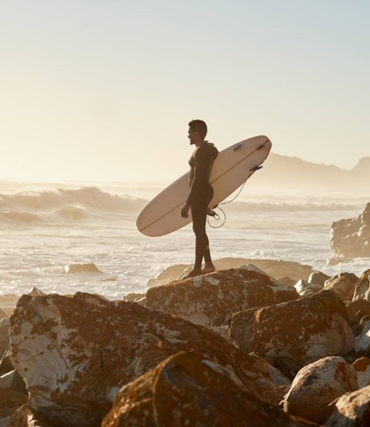
Introduction
The Tourism Recommendation System is designed to assist travelers in discovering new destinations by providing personalized recommendations based on their preferences and interests.
By analyzing textual descriptions of cities and places, the system aims to offer insightful suggestions, enhancing the overall travel experience for users.

Slide 5
Objectives
To create a user-friendly interface that allows users to easily explore and discover new travel destinations based on their preferences.
To utilize machine learning techniques to provide accurate and personalized recommendations, improving user satisfaction and engagement.

Slide 6
Software Requirements
HARDWARE
SOFTWARE
System : 12th Gen Intel(R) Core(TM) i5-1235U 1.30 GHz
Hard Disk : 512 GB SSD
Monitor: 15’’ LED
Input Devices: Keyboard, Touchpad
RAM: 16 GB
Operating System: Windows11 Home
Language: Python
Software Used: Anaconda Navigator

Slide 7
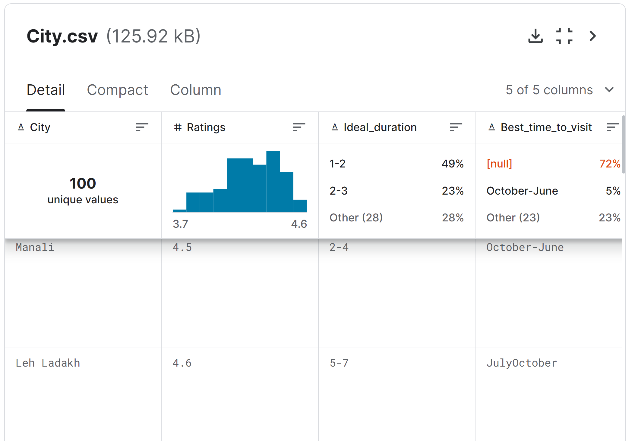
Dataset
Dataset Link: https://www.kaggle.com/datasets/naqibahmedkadri/famous-indian-touristplaces

Slide 8
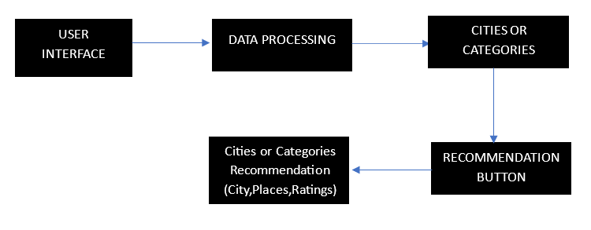
Architecture Diagram

Slide 9

Conclusion
The tourism recommendation system successfully provides personalized recommendations for places to visit based on user preferences, enhancing the travel planning experience.
By leveraging machine learning techniques like TF-IDF Vectorization and Cosine Similarity, the system efficiently matches user-selected cities or categories to relevant places, ensuring tailored recommendations.
The project demonstrates the practical application of data science in enhancing user experiences, with potential for further enhancements and integration into travel planning platforms.

Slide 10
Future Enhancements
Integration of real-time data: Enhancing the system to incorporate real-time data on crowd levels, weather conditions, and special events, providing more accurate and up-to-date recommendations.
User profiling and personalization: Implementing user profiling to track preferences and behavior, enabling the system to offer more personalized recommendations over time.
Social media integration: Adding features to share travel plans, experiences, and recommendations on social media platforms, fostering community engagement and providing social context to recommendations.

Slide 11
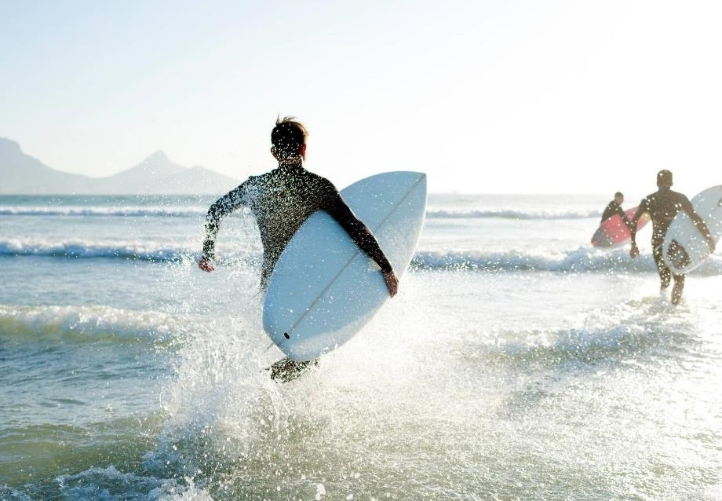
Thank you

